Slide 1
Evolutionary Medicine
Chapter 1
Evolutionary Medicine

Slide 2
Outline
Introduction
Some Non-Evolutionary Views of Human Health and Disease
An Evolutionary Approach to Human Health and Disease

Slide 3
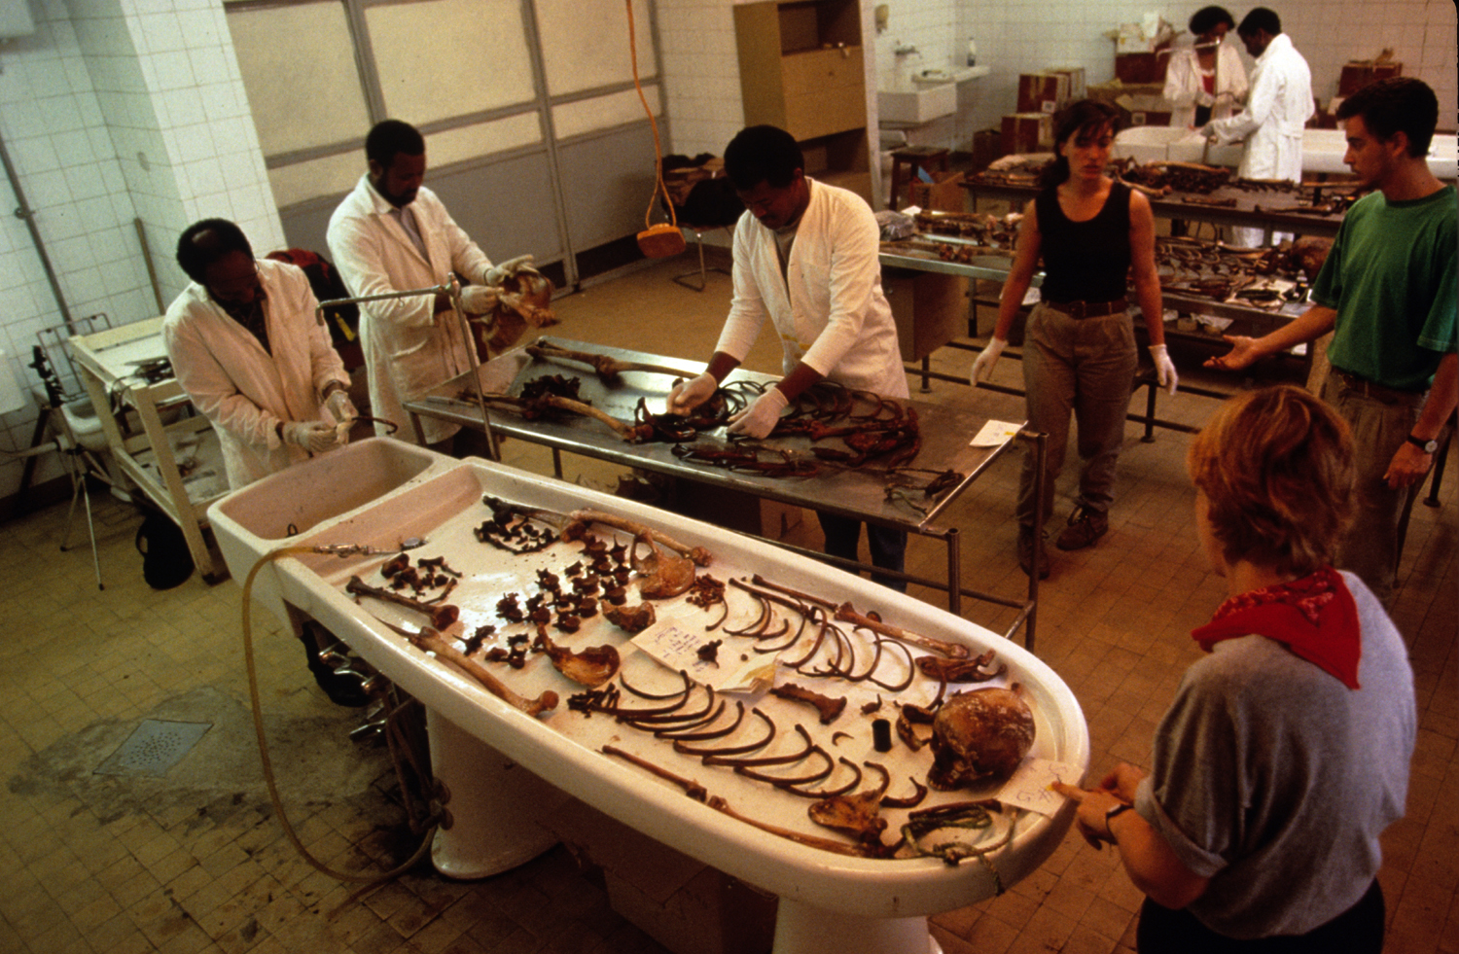
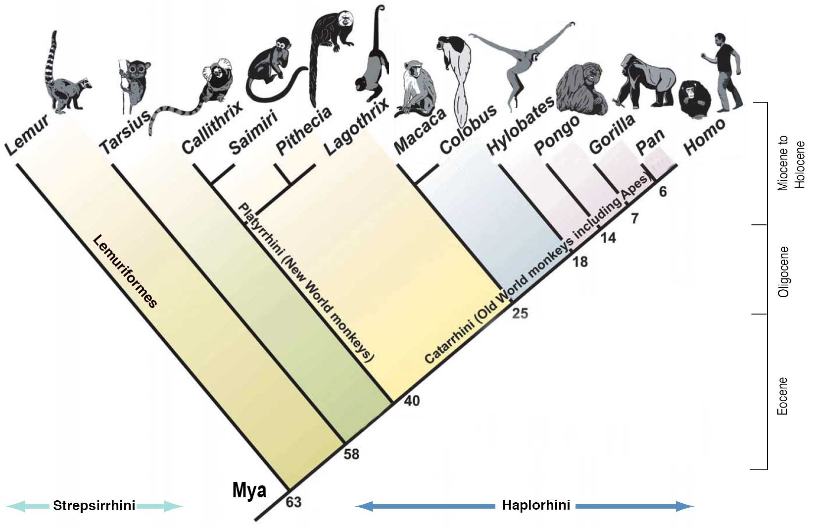

What is Biological Anthropology?
Biological Anthropologists view humans as the products of:
  1. A long evolutionary history
  2. An individual life history

Slide 4
Introduction
“We propose that each person presenting to a physician has three relevant histories: the history of the complaint itself; the developmental history of that individual; and his or her evolutionary history.”
  Gluckman et al., 2009, p. xv.

Slide 5
Some Non-Evolutionary Views of Human Health and Disease
Much of “western” medical science today
  Focused on proximate mechanisms
  Normal/healthy vs. dysfunctional/pathological
  Less concerned with human variation

Slide 6
CAIM
Complementary, alternative, and integrative medicine
  Yoga, meditation, mindfulness
  Acupuncture
  Homeopathy
  Vitamins and supplements

Slide 7
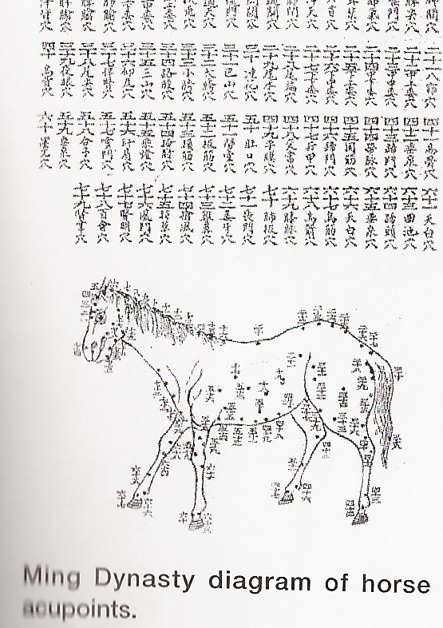
Chinese Traditional Medicine (CTM)
  Examples:
  Ginseng a special herb (effects
  perhaps through saponins, placebo,
  etc.)
  Artemisinin, derived from
  wormwood, has been used widely
  against malaria
  Tai chi
  Acupuncture
Yuqun L. 2011. Traditional Chinese Medicine. Cambridge: Cambridge University Press.

Slide 8
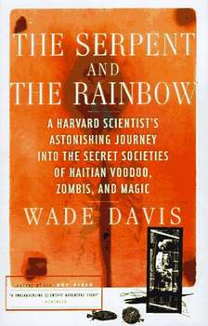
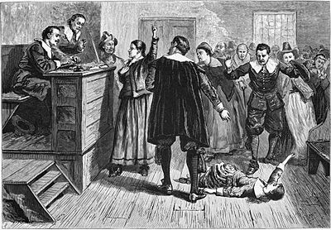
Social Etiology of Health and Disease
Haitian zombies, Salem witch trials, etc.

Slide 9

An Evolutionary Approach to Human Health and Disease
An understanding of how the body has been ‘designed’ by evolutionary processes, including natural selection, may also help understand health and illness
As an example, selection favors traits that enhance reproductive success rather than health or longevity

Slide 10
An Evolutionary Approach to Human Health and Disease
Explicit interest in individual and population variation rather than ideal types (e.g., “the rat” or “the human”)
Often features a life course perspective, highlighting the role of development and life history tradeoffs among competing agendas of growth, maintenance and reproduction

Slide 11
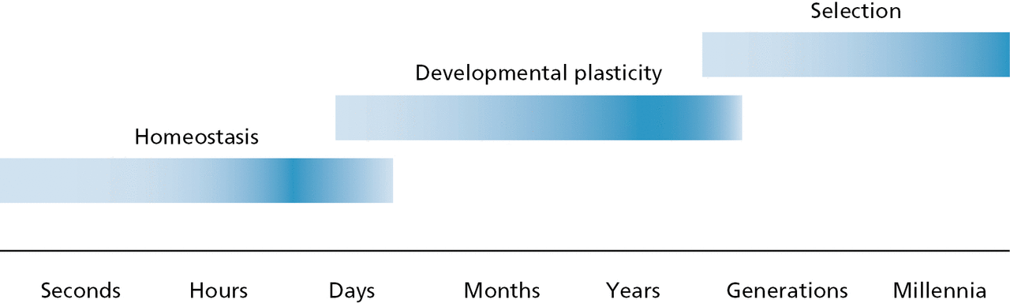
Variable Time Scales
“[T]he density of innervation and thus the capacity to sweat and tolerate extreme heat is influenced by whether the infant is brought up in a warm or cold environment.” Gluckman et al., p. 13

Slide 12
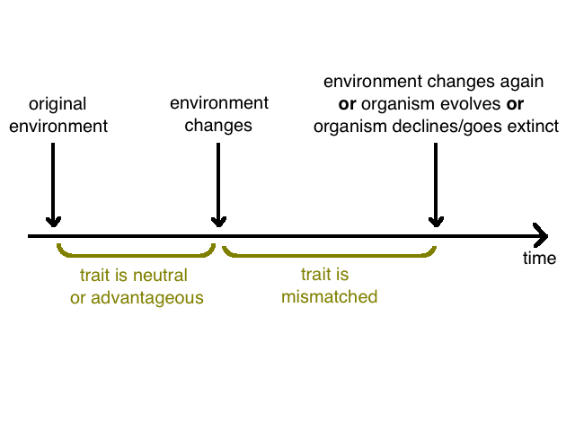
Mismatches
An evolutionary approach sometimes points to rapid environmental changes having health consequences.

Slide 13
Proximate vs. Ultimate Causation
What is the mechanism underlying the phenomenon of interest?
How does the phenomenon develop during the lifetime of the individual?
What is the function of the phenomenon? How does it serve the organism’s interests?
How did the phenomenon evolve? What is its evolutionary history (phylogeny)?

Slide 14


Why do you sweat when you’re nervous or frightened?
Mechanism?
Development?
Function?
Phylogeny?

Slide 15

Why do you feel pain?
Use Niko Tinbergen’s four ’why’ questions to try and answer this question: Why do we feel pain?
Watch this short video for some insight into why pain (unpleasant as it is) is vital.
Click here for the video: Teen Who Feels No Pain Counts Her Blessings

Slide 16
Some examples of evolutionary perspectives of health & disease

Slide 17
Adult Lactose Intolerance
  Is this a disease?
  Could this be adaptive human variation?
Most mammals lose the ability to digest lactose after weaning.

Slide 18
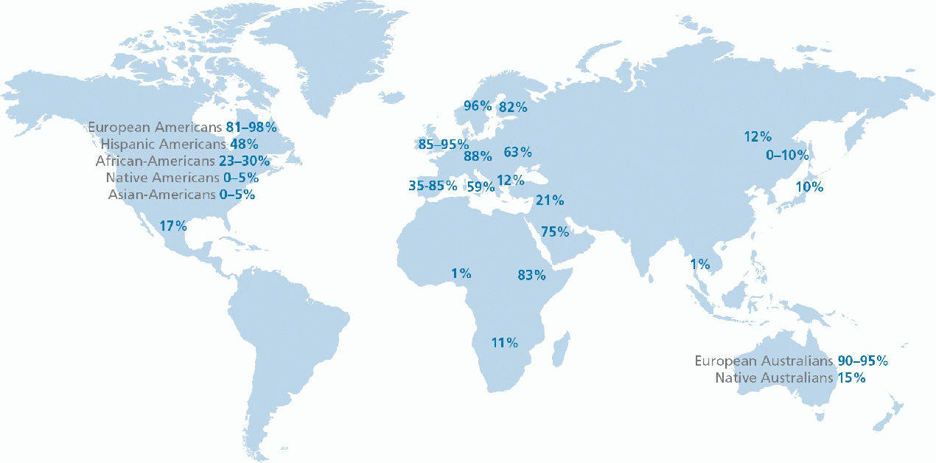
Adult Lactose Intolerance

Slide 19

Part Biology, Part Culture
The evolution of genotypes that produce lactase (the enzyme that digests lactose) are more prevalent in populations where dairy agricultural practices emerged earlier.
But, several populations have a high consumption of dairy products despite also high rates of lactose intolerance. Why?

Slide 20
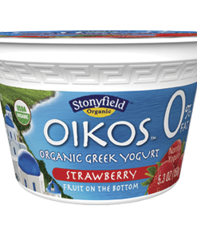
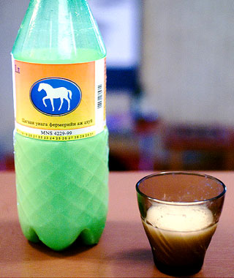
Adult Lactose Intolerance
Cultural means to reduce lactose content: Greek yogurt, Mongolian airag, cheese, etc.
Fermented dairy contains less lactose.

Slide 21

Breast Cancer
How to account for cancers from an evolutionary perspective?

Slide 22
Breast Cancer
Reductions in extrinsic mortality (such as predation and accidents), yielding greater mortality related to chronic diseases
  Human evolution and cancers
  Other species and cancers
Trade-offs: Female tissues sensitive to growth factors to enhance fitness at expense to reproductive cancers
Energetics and development: Population variation in breast cancer related to diet and other metabolic factors

Slide 23
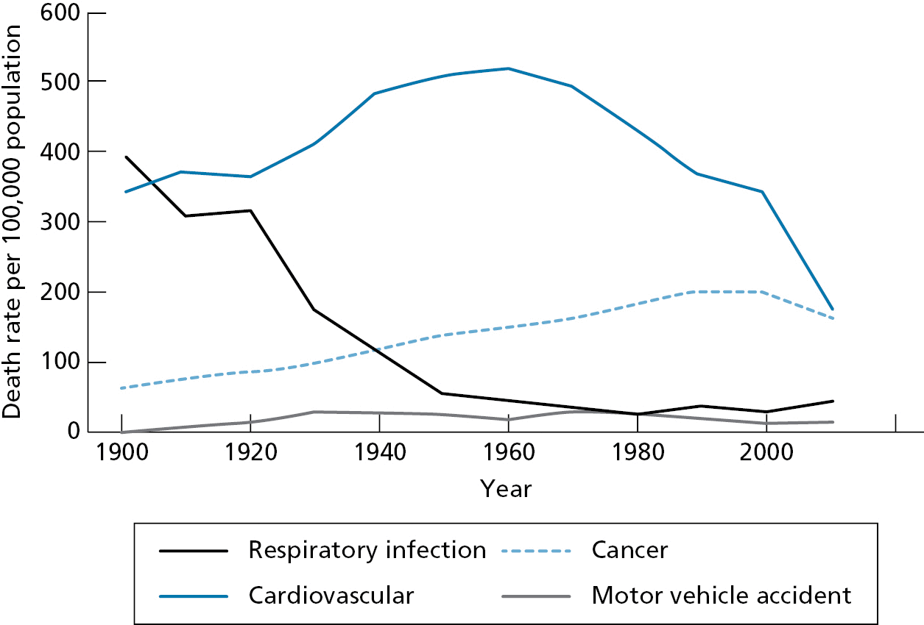
Breast Cancer
Changes in US disease profile: 1900-2000

Slide 24
Evolutionary Theory
The basics of evolutionary theory help account for the processes by which humans (and other species) have evolved
By understanding evolutionary theory, we can apply these principles to better understand modern day health and disease.

Slide 25
Evolutionary Theory
The universe is about 13 billion years old, Earth about 4.6 billion years old, and life on earth traceable to at least 3.8 billion years in the past
The origins of life on earth (from sun or Earth’s core; originally an RNA world?) are subject to continued debate

Slide 26
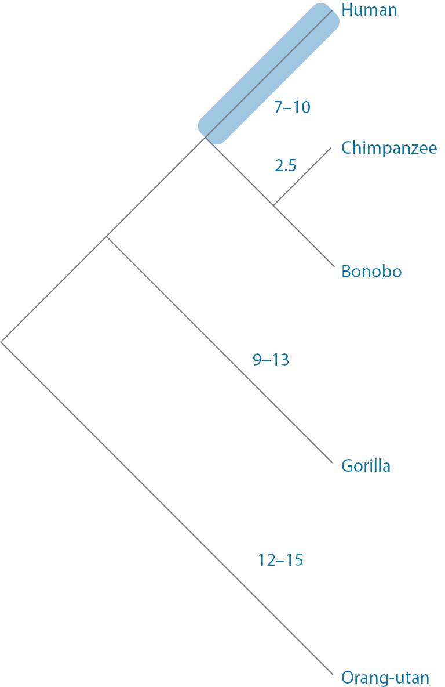
Evolution of Life on Earth

